Slide 1
Data Interpretation

Slide 2
Data Interpretation
Introduction to DI and discussion on different types of Data
Average, Percentage, Approximation and Ratio concept introduction
Concepts of Bar Graphs & Line Graph
Concepts of Table Charts
Concepts of Pie Charts
Concepts of Boxplots
Concept of Mixed Charts

Slide 3
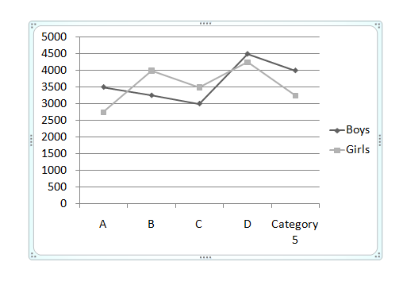
Data Interpretation
Directions: On the basis of the figure below answer the following question. In the graph, the number of boys and girls are given in five schools. Study this graph properly and answer the questions.

Slide 4
Data Interpretation
Q1.What approx. percentage will be the number of girls in school A out of the total number of girls in all the schools?
A) 15
B) 17
C) 22
D) 24
Notes:
Difficulty Level: Easy(Compulsory)
Correct option: A
the total number of girls is 17750 and the girls in school A as a part of all the girls in all the schools will be (2750/17750) x 100 = 15.4%

Slide 5
Data Interpretation
Q2.Which class has the highest percentage of boys and girls with respect to the total students in all the schools?
A) A
B) B
C) C
D) D
Notes:
Difficulty Level: Easy (Optional)
Correct option: D
From the figure you can see the highest of boys and girls in one school is in D.
As the base for all the schools remains a same i.e. total number of students all the schools will be same for every school then we can say that in school the percentage of students is the highest

Slide 6
Data Interpretation
Q3.Which school has the lowest number of students?
A) A
B) B
C) C
D) D
Notes:
Difficulty Level: Easy(Compulsory)
Correct option: A
In school A the number of students is the lowest.

Slide 7
Data Interpretation
Q4.What is the percentage of girls in school B w.r.t boys of school D?
A) 88.89%
B) 78.89%
C) 66.67%
D) 82.22%
Notes:
Difficulty Level: Easy(Optional)
Correct option: A

Slide 8
Data Interpretation
Q5.What is the ratio of 40% boys of school A to 30% girl of school C?
A) 4: 3
B) 2: 3
C) 3: 4
D) 4: 5
Notes:
Difficulty Level: Moderate (Optional)
Correct option: A
In school A the number of students is the lowest.

Slide 9
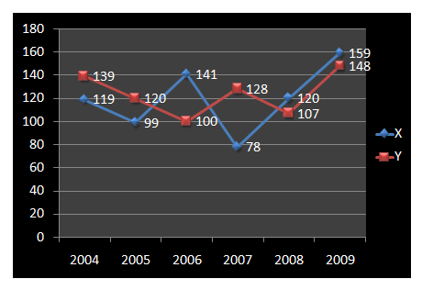
Data Interpretation
Directions: In the given figure number of mobiles prepared by two different companies is given from 2004 to 2009. Answer the questions based on the figure below. (the values are in thousands)

Slide 10
Data Interpretation
Q6.What will be the difference in the number of mobiles made by the company X in the year 2004 and 2005?
A) 10000
B) 20000
C) 30000
D) 40000
Notes:
Difficulty Level: Easy(Compulsory)
Correct option: B

Slide 11
Data Interpretation
Q7.The production of the mobile by the company Y was how much percentage of the production by company X in the year 2007?
A) 120
B) 148
C) 152
D) 164
Notes:
Difficulty Level: Easy (Optional)
Correct option: D

Slide 12
Data Interpretation
Q8.What was the maximum difference between the manufacturing of mobiles by both the companies?
A) 40000
B) 41000
C) 45000
D) 50000
Notes:
Difficulty Level: Easy (Compulsory)
Correct option: D

Slide 13
Data Interpretation
Q9.Mobile phones of company X in 2009 is approximately how much percent more than the mobile phones of company Y in 2004?
A) 10.11%
B) 16.5%
C) 12.14%
D) 14.39%
Notes:
Difficulty Level: Moderate (Optional)
Correct option: D

Slide 14
Data Interpretation
Q10.What is the ratio of mobile phones of company X in 2008 to mobile phones of company Y in 2006?
A) 8: 9
B) 5: 6
C) 6: 5
D) 4: 5
Notes:
Difficulty Level: Moderate (Compulsory)
Correct option: C

Slide 15
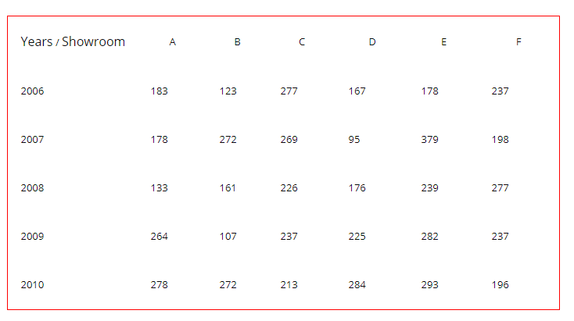
Data Interpretation
Directions: The table below shows the number of the laptops that were sold by the showrooms in the years from 2006 to 2010. Answer the below questions based on the information given in the table.

Slide 16
Data Interpretation
Q11.What will be an average number of laptops sold by showroom D in given period?
A) 192.4
B) 189.4
C) 204.4
D) 213.4
Notes:
Difficulty Level: Easy(Compulsory)
Correct option: B

Slide 17
Data Interpretation
Q12.What will be an average number of laptops sold by all the showrooms in the year 2007?
A) 231
B) 222
C) 208
D) 213
Notes:
Difficulty Level: Moderate(Compulsory)
Correct option: A
We know the formula for the average which is total laptop sold in 2007/number of stores.
Here total number of laptops = (178 + 272 + 269 + 95 + 379 + 198) = 1294
Number of laptop showrooms are 6.
So, 1391/6 = 231.33.
So the correct answer is 231.

Slide 18
Data Interpretation
Q13.By how much percentages the laptops sold by the showroom E in 2008 were less than the showroom A in 2010?
A) 10
B) 12
C) 14
D) 16
Notes:
Difficulty Level: Moderate (Optional)
Correct option: C
The total number of laptops there were sold by E in 2008 = 239.
The total number of laptops be ((278 – 239)/278) * 100 = 14.02 %
As the values in the question are rounded off to nearest integer the correct answer 14%.

Slide 19
Data Interpretation
Q14.Laptops sold by showroom A in 2010 is how much more percent than the laptops sold by showroom F in 2007?
A) 40.40%
B) 50.50%
C) 60.60%
D) 70.70%
Notes:
Difficulty Level: Moderate(Compulsory)
Correct option: A

Slide 20
Data Interpretation
Q15.What will be the ratio of total laptops sold by B and C in 2007 to laptops sold by D and E in 2010?
A) 541: 577
B) 466: 571
C) 641: 677
D) 213: 331
Notes:
Difficulty Level: Moderate (Optional)
Correct option: A

Slide 21
Data Interpretation
Direction: Study the following table and answer the questions based on it:
Expenditures of a Company (in Lakh Rupees) per Annum Over the given Years
Year | Item of Expenditure
 | Salary | Fuel and Transport | Bonus | Interest on Loans | Taxes
1998 | 288 | 98 | 3.00 | 23.4 | 83
1999 | 342 | 112 | 2.52 | 32.5 | 108
2000 | 324 | 101 | 3.84 | 41.6 | 74
2001 | 336 | 133 | 3.68 | 36.4 | 88
2002 | 420 | 142 | 3.96 | 49.4 | 98
What is the average amount of interest per year which the company had to pay during the period 1998 to 2001?
A) Rs. 32.435 lakhs
B) Rs. 33.475 lakhs
C) Rs. 34.185 lakhs
D) Rs. 36.666 lakhs
Notes:
Difficulty Level: Moderate(Compulsory)
Option: B

Slide 22
Data Interpretation
Direction: Study the following table and answer the questions based on it:
Expenditures of a Company (in Lakh Rupees) per Annum Over the given Years
Year | Item of Expenditure
 | Salary | Fuel and Transport | Bonus | Interest on Loans | Taxes
1998 | 288 | 98 | 3.00 | 23.4 | 83
1999 | 342 | 112 | 2.52 | 32.5 | 108
2000 | 324 | 101 | 3.84 | 41.6 | 74
2001 | 336 | 133 | 3.68 | 36.4 | 88
2002 | 420 | 142 | 3.96 | 49.4 | 98
The total amount of bonus paid by the company during the given period is approximately what percent of the total amount paid on fuel & transport during this period?
A) 1%
B) 1.5%
C) 2%
D) 3%
Notes:
Difficulty Level: Moderate(Compulsory)
Option: D

Slide 23
Data Interpretation
Direction: Study the following table and answer the questions based on it:
Expenditures of a Company (in Lakh Rupees) per Annum Over the given Years
Year | Item of Expenditure
 | Salary | Fuel and Transport | Bonus | Interest on Loans | Taxes
1998 | 288 | 98 | 3.00 | 23.4 | 83
1999 | 342 | 112 | 2.52 | 32.5 | 108
2000 | 324 | 101 | 3.84 | 41.6 | 74
2001 | 336 | 133 | 3.68 | 36.4 | 88
2002 | 420 | 142 | 3.96 | 49.4 | 98
Total expenditure on all these items in 1999 was approximately what percent of the total expenditure in 2002?
A) 83%
B) 80%
C) 85%
D) 79%
Notes:
Difficulty Level: Moderate(Compulsory)
Option: A

Slide 24
Data Interpretation
Direction: Study the following table and answer the questions based on it:
Expenditures of a Company (in Lakh Rupees) per Annum Over the given Years
Year | Item of Expenditure
 | Salary | Fuel and Transport | Bonus | Interest on Loans | Taxes
1998 | 288 | 98 | 3.00 | 23.4 | 83
1999 | 342 | 112 | 2.52 | 32.5 | 108
2000 | 324 | 101 | 3.84 | 41.6 | 74
2001 | 336 | 133 | 3.68 | 36.4 | 88
2002 | 420 | 142 | 3.96 | 49.4 | 98
The total expenditure of the company over these items during the year 2001 is?
A) Rs. 544.44 lakhs
B) Rs. 597.08 lakhs
C) Rs. 446.46 lakhs
D) Rs. 478.87 lakhs
Notes:
Difficulty Level: Moderate(Optional)
Option: B

Slide 25
Data Interpretation
Direction: Study the following table and answer the questions based on it:
Expenditures of a Company (in Lakh Rupees) per Annum Over the given Years
Year | Item of Expenditure
 | Salary | Fuel and Transport | Bonus | Interest on Loans | Taxes
1998 | 288 | 98 | 3.00 | 23.4 | 83
1999 | 342 | 112 | 2.52 | 32.5 | 108
2000 | 324 | 101 | 3.84 | 41.6 | 74
2001 | 336 | 133 | 3.68 | 36.4 | 88
2002 | 420 | 142 | 3.96 | 49.4 | 98
The ratio between the total expenditure on Taxes for all the years and the total expenditure on Fuel and Transport for all the years respectively is approximately?
A) 445:708
B) 451:586
C) 152:183
D) 534:845
Notes:
Difficulty Level: Moderate(Compulsory)
Option: B

Slide 26
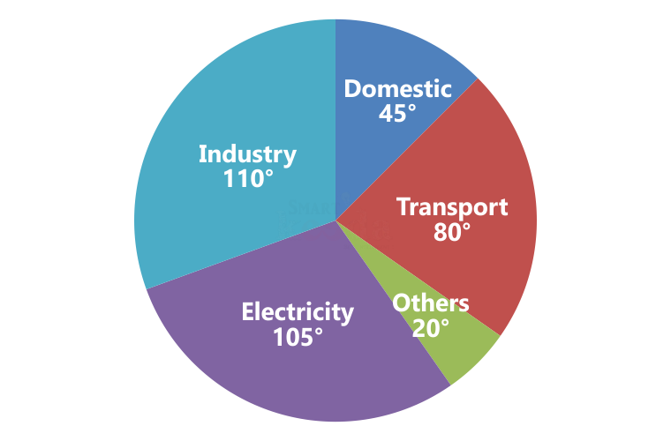
Directions: Study the following graph carefully & answer the questions given below it.
The basic fuel expenditure of a country is dominated by four major uses - Domestic, Transport, Industry and Electricity. In 1992, the total amount of energy used was equivalent to 600 million tones of coal.
Q1.The energy consumed for other purposes is approximately what percentage of total energy consumed for the other four major uses in 1992 was?

Slide 27
Directions: Study the following graph carefully & answer the questions given below it.
The basic fuel expenditure of a country is dominated by four major uses - Domestic, Transport, Industry and Electricity. In 1992, the total amount of energy used was equivalent to 600 million tones of coal.
Q2.What is difference between energy used for domestic purposes and other purposes in the country in 1992?

Slide 28
Directions: Study the following graph carefully & answer the questions given below it.
The basic fuel expenditure of a country is dominated by four major uses - Domestic, Transport, Industry and Electricity. In 1992, the total amount of energy used was equivalent to 600 million tones of coal.
Q3. The difference between the fuel consumption of Industry and Transport in 1992 was equal to?

Slide 29
Directions: Study the following graph carefully & answer the questions given below it.
The basic fuel expenditure of a country is dominated by four major uses - Domestic, Transport, Industry and Electricity. In 1992, the total amount of energy used was equivalent to 600 million tones of coal.
Q4. If the energy requirement of electricity in 1992 were 350 million tones, the amount of additional primary energy required would be?

Slide 30
Directions: Study the following graph carefully & answer the questions given below it.
The basic fuel expenditure of a country is dominated by four major uses - Domestic, Transport, Industry and Electricity. In 1992, the total amount of energy used was equivalent to 600 million tones of coal.
Q5. If instead of coal, oil has been used in industry purposes and if 1 tone of coal is equivalent to 3/4 tones of oil, what approximate amount of oil will be required in industry?

Slide 31
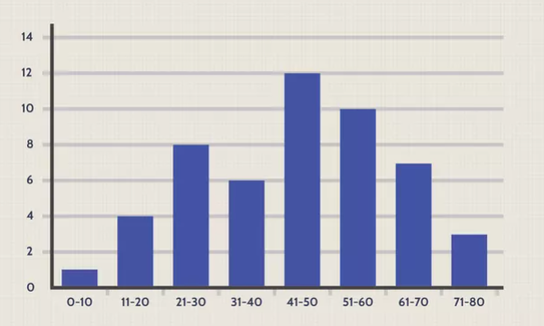
A histogram is a graphical representation that organizes a group of data points into user-specified ranges. Similar in appearance to a bar graph, the histogram condenses a data series into an easily interpreted visual by taking many data points and grouping them into logical ranges or bins.

Slide 32
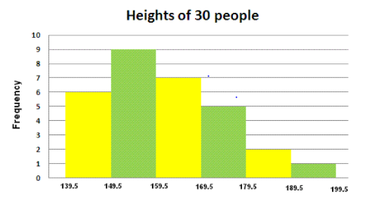
The histogram below shows the heights (in cm) distribution of 30 people.
a) How many people have heights between 159.5 and 169.5 cm?

Slide 33
The histogram below shows the heights (in cm) distribution of 30 people.
b) How many people have heights less than 159.5 cm?

Slide 34
The histogram below shows the heights (in cm) distribution of 30 people.
c) How many people have heights more than 169.5 cm?

Slide 35
The histogram below shows the heights (in cm) distribution of 30 people.
d) What percentage of people have heights between 149.5 and 179.5 cm?

Slide 36
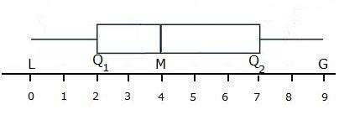
A box plot graphically displays groups of numerical data through their five-number summaries: the smallest observation (sample minimum), lower quartile (Q1), median (M), upper quartile (Q2), and largest observation (sample maximum). The quartiles of a set of values are the three points that divide the data set into four equal groups, each representing a fourth of the population being sampled. The box plot is often called a "whisker" plot because "whiskers" extend outward from the boxes to the least and greatest values. Graphically, a box plot looks like the following:
A measure of the dispersion of the data that is shown in a box plot is called the interquartile range, which is the difference between the upper quartile and the lower quartile.

Slide 37
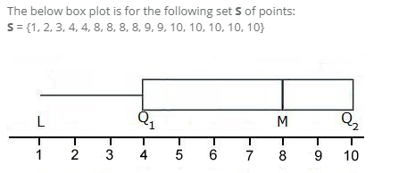
Question:--The upper quartile is

Slide 38
Question: The lower quartile is

Slide 39
Question: What is The lowest data point ?

Slide 40
Question: What is the interquartile range for S?

Slide 41
Question: The largest observation is?

Slide 42
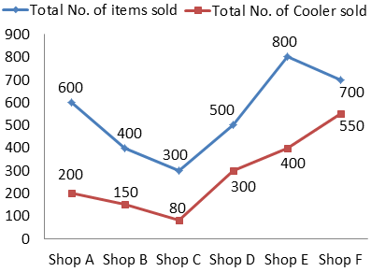
Data Interpretation
Directions: Study the following line and table chart carefully and answer the questions given below:
The following line graph shows the total number of items sold by different shops from January to June 2019.
The following table shows the ratio of defective Cooler sold to the defective AC sold
Shops | Cooler : AC
Shop A | 2 : 1
Shop B | 5 : 6
Shop C | 1 : 2
Shop D | 4 : 1
Shop E | 1 : 1
Shop F | 3 : 1
Note: The total number of items = Cooler + AC + Others

Slide 43
Data Interpretation
In shop A, the ratio of total number of AC sold to that of the total number of Others items sold is 1 : 3 and the total number of non-defective AC sold by shop A is 40, then find the total number of defective Coolers sold by shop A?
A) 50
B) 120
C) 130
D) 140
Shops | Cooler : AC
Shop A | 2 : 1
Shop B | 5 : 6
Shop C | 1 : 2
Shop D | 4 : 1
Shop E | 1 : 1
Shop F | 3 : 1
Note: The total number of items = Cooler + AC + Others
Notes:
Difficulty Level: Expert(Compulsory)
Correct option: B

Slide 44
Data Interpretation
If the total number of Others items sold by shop B and shop C together is 180, then find the difference between the total number of AC sold by shop B and shop C together to that of the total number of Coolers sold by shop E and shop F together?
A) 660
B) 720
C) 740
D) 680
Shops | Cooler : AC
Shop A | 2 : 1
Shop B | 5 : 6
Shop C | 1 : 2
Shop D | 4 : 1
Shop E | 1 : 1
Shop F | 3 : 1
Note: The total number of items = Cooler + AC + Others
Notes:
Difficulty Level: Expert(Compulsory)
Correct option: A

Slide 45
Data Interpretation
The total number of defective AC sold by shop D is “X” and the total number of Others items sold by shop D is “4X”. If the total number of non-defective Coolers sold by shop D is 220, then find the value of “4X”.
A) 100
B) 80
C) 60
D) 120
Shops | Cooler : AC
Shop A | 2 : 1
Shop B | 5 : 6
Shop C | 1 : 2
Shop D | 4 : 1
Shop E | 1 : 1
Shop F | 3 : 1
Note: The total number of items = Cooler + AC + Others
Notes:
Difficulty Level: Expert(Compulsory)
Correct option: B

Slide 46
Data Interpretation
If in shop F, 10% of the Others items were sold out of the total number of items sold. The total number of AC sold by shop F is equal to the total number of Others items sold by Shop C, then the total number of AC sold by shop C is what percentage of the total number of Coolers sold by shop C?
A) 225%
B) 150%
C) 100%
D) 175%
Shops | Cooler : AC
Shop A | 2 : 1
Shop B | 5 : 6
Shop C | 1 : 2
Shop D | 4 : 1
Shop E | 1 : 1
Shop F | 3 : 1
Note: The total number of items = Cooler + AC + Others
Notes:
Difficulty Level: Expert(Compulsory)
Correct option: D

Slide 47
Data Interpretation
If the average number of AC sold by all shops is 140, then find the difference between the total number of Coolers sold by all shops together to that of the total number of Others items sold by all shops together?
A) 850
B) 950
C) 900
D) 1100
Shops | Cooler : AC
Shop A | 2 : 1
Shop B | 5 : 6
Shop C | 1 : 2
Shop D | 4 : 1
Shop E | 1 : 1
Shop F | 3 : 1
Note: The total number of items = Cooler + AC + Others
Notes:
Difficulty Level: Expert (Optional)
Correct option: C

Slide 48
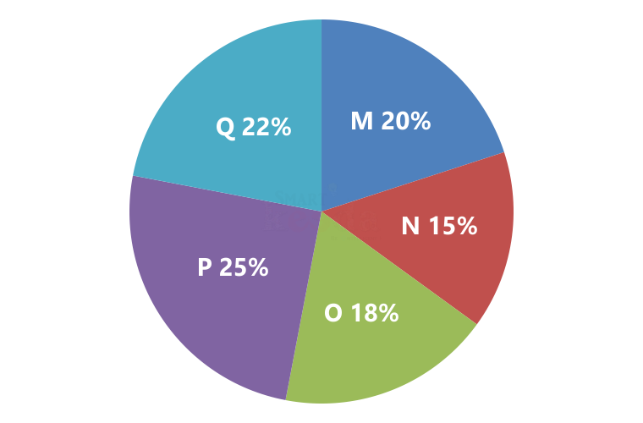
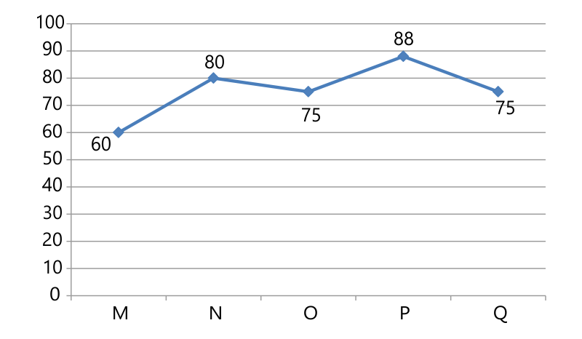
Data Interpretation
Directions: Study the following information carefully and answer the question given below:
Pie chart shows the production of rice by 5 different factories and line chart shows the percentage of sale.
Total production = 5400 kg
Q26.What is the ratio of rice sold by factory P to the rice sold by factory N? (CO-5)-Difficult
A) 71: 54
B) 77: 51
C) 77: 48
D) 69: 47
Notes:
Difficulty Level: Expert(Compulsory)
Option: C

Slide 49
Data Interpretation
Directions: Study the following information carefully and answer the question given below:
Pie chart shows the production of rice by 5 different factories and line chart shows the percentage of sale.
Total production = 5400 kg
Q27.If the cost price of rice is Rs. 45 per kg and profit earned by factory N on 1 kg rice is 20% of the cost price, find the total profit earned by factory N. (CO-5)-Difficult
A) Rs. 4374
B) Rs. 5256
C) Rs. 5346
D) Rs. 5697
Notes:
Difficulty Level: Expert (Optional)
Option: C

Slide 50
Data Interpretation
Directions: Study the following information carefully and answer the question given below:
Pie chart shows the production of rice by 5 different factories and line chart shows the percentage of sale.
Total production = 3600 kg
If the cost price of rice is Rs. 45 per kg and profit earned by factory O on 1 kg rice is 20% of the cost price, find the total profit earned by factory O.
A) Rs. 4374
B) Rs. 5256
C) Rs. 5346
D) Rs. 5697
Notes:
Difficulty Level: Expert(Compulsory)
Option: A

Slide 51
Data Interpretation
Directions: Study the following information carefully and answer the question given below:
Pie chart shows the production of rice by 5 different factories and line chart shows the percentage of sale.
Total production = 3600 kg
Rice sold by factory M and N together is how much percent more than the production of rice by factory N?
A) 30%
B) 60%
C) 10%
D) 20%
Notes:
Difficulty Level: Expert (Optional)
Option: B

Slide 52
Data Interpretation
Directions: Study the following information carefully and answer the question given below:
Pie chart shows the production of rice by 5 different factories and line chart shows the percentage of sale.
Total production = 3600 kg
In which of the following factory the sale of rice is the lowest?
A) Factory P
B) Factory Q
C) Factory M
D) Factory O
Notes:
Difficulty Level: Expert (Optional)
Option: C

Slide 53
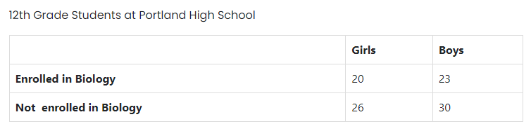
Q21. Approximately what is the percentage of the 12th grade girls at Portland High School who are not enrolled in Biology? (CO-4)-Difficult
A.43%
B.56.52%
C.42%
D.48%

Slide 54
Q22. What is the fraction of the girls in the 12th grade at Portland High School who are enrolled in Biology? (CO-4)-Difficult
A.20/99
B.21/99
C.26/99
D.22/99

Slide 55
Q23. What is the ratio of the 12th grade girls who are enrolled in Biology compared to all the 12th grade students at Portland High School? (CO-4)-Difficult
A.20:23
B.20:99
C.23:99
D.30:99

Slide 56
Q24.Find the average number of girls admitted in Portland school on the basis of category mentioned here? (CO-4)-Difficult
A.30
B.23
C.28
D.20

Slide 57
Q25.Find the percentage of total girls with respect to the total boys? (CO-4)-Difficult
A.86.79%
B.47%
C.52.63%
D.52%

Slide 58
Any Doubts???

